Slide 1
Regulation of blood glucose levels

Slide 2
The need for glucose
Glucose is important in supplying energy to
all the cells in our body. Energy is released
from glucose in the presence of oxygen and
this is called cellular respiration. Without
glucose our cells would die.
Food replenishes the blood glucose levels in
our body and so keeps our energy levels up.

Slide 3
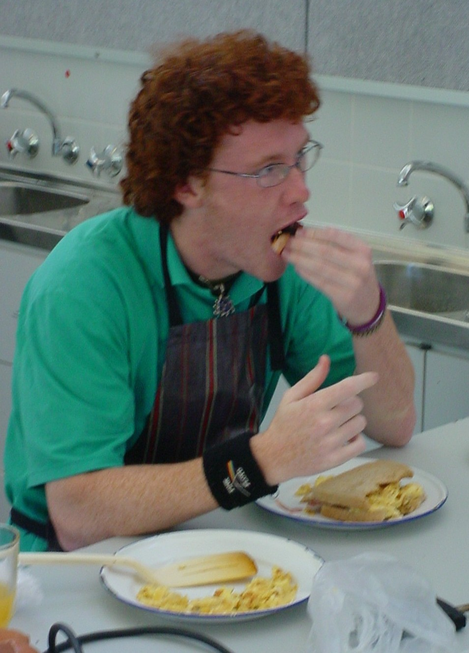
Luke increasing his blood sugar levels with a great breakfast. Go Luke!!

Slide 4
Pancreas, liver and adrenal glands
These three organs play a very important
role in controlling our blood sugar levels.
The pancreas and adrenal glands secrete
hormones that affect the level of glucose in
the blood. The liver stores glucose as
glycogen and can manufacture glucose from
lactic acid, fatty acids or amino acids.

Slide 5
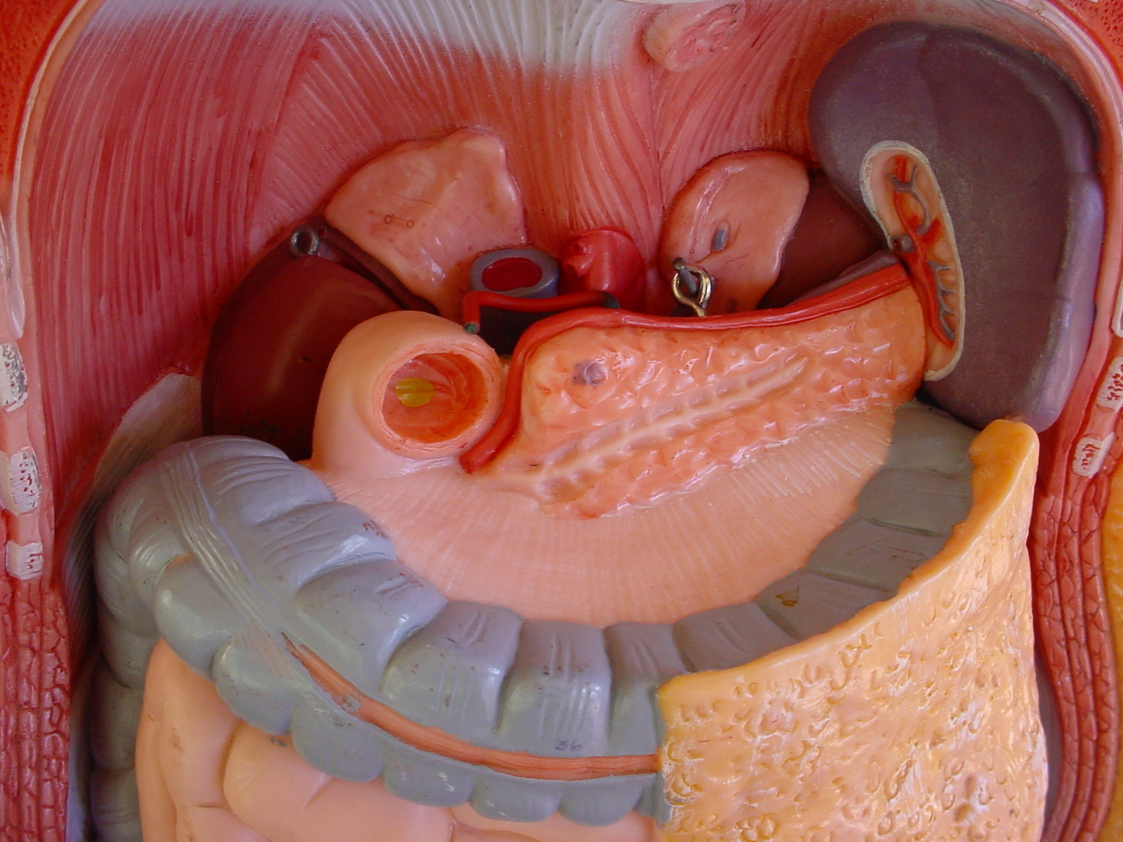
The pancreas
Luke’s pancreas contains
clusters of hormone
secreting cells called the
islets of Langerhans.
These islets contain cells of
two different types:
(1) alpha cells secreting
glucagon
(2) beta cells secreting insulin
pancreas
duodenum

Slide 6
The role of the beta cells in the pancreas
With rising blood sugar levels, Luke’s beta cells
in his pancreas are stimulated to secrete
insulin. Insulin causes a decrease in blood
sugar levels by converting glucose to glycogen
in a process known as glycogenesis. Glycogen
can then be stored in Luke’s liver or in his skeletal
muscles, ready to be converted back to glucose
very quickly.
In the beginning BIG was a convert to glycogen.

Slide 7
The role of the alpha cells in the pancreas
With decreasing blood sugar levels, the alpha cells
in the pancreas are stimulated to secrete
glucagon. Glucagon causes an increase in blood
sugar levels by converting glycogen to glucose
in a process known as glycogenolysis. Glycogen
stored in the liver and skeletal muscles can be
released as glucose very quickly.
Old sis glide causes AG glucose.

Slide 8
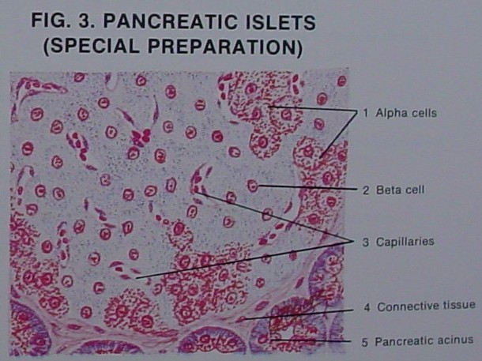

Slide 9
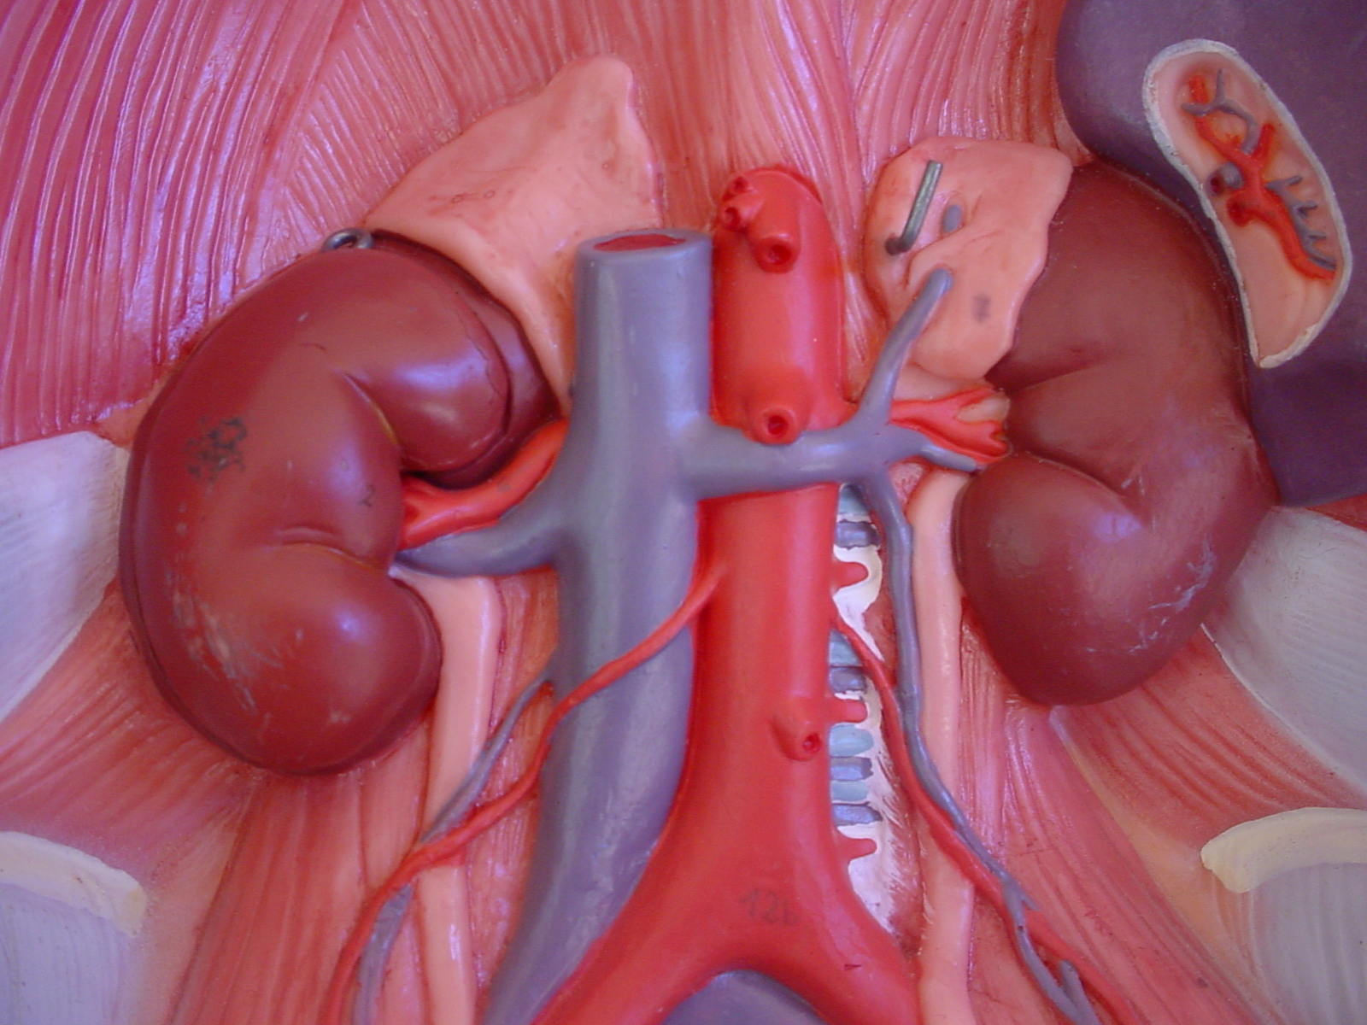
The adrenal glands
Luke’s adrenal glands
contain the adrenal
cortex (that secrets cortisol
and the adrenal medulla
(that secretes adrenaline
(epinephrine) and
noradrenaline
(norepinephrine).

Slide 10
The role of cortisol in the adrenal glands
Anterior lobe of the pituitary gland →ACTH
adrenal cortex → cortisol.
Cortisol regulates carbohydrate metabolism by ensuring enough energy is provided to the cells. As a result cortisol
stimulates conversion of glycogen to glucose,
increases the rate at which amino acids are removed from cells and transported to the liver (which can be converted to glucose by the liver)
promotes the mobility of fatty acids to allow muscle cells to shift from glucose to fatty acids for much of their metabolic energy.

Slide 11
The role of adrenaline in the adrenal glands
Adrenaline elevates blood glucose levels in
time of stress (flight or fight or exercise) and
in so doing counteracts the effects of insulin.
This in turn stimulates the production of
lactic acid from glycogen in muscle cells and
this lactic acid can then be used by the liver
to manufacture glucose.

Slide 12
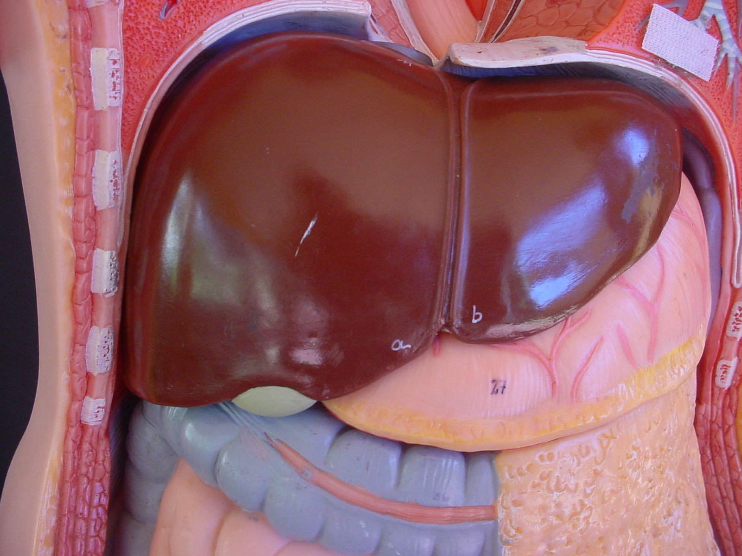
The liver
The liver situated in the
upper part of the
abdominal cavity is the
largest gland in the
body.
It can store 100g of
glucose.
Skeletal muscle can
store 400g of glucose.

Slide 13
The role of the liver
To use glucose in a variety of ways:
(1) removed to provide energy for liver functioning
(2) to convert it into glycogen for storage
(3) allow it to continue to circulate in the blood to provide energy for body cells or excess converted to fat.
To convert amino acids, lipids or lactic acid to
glucose in a process known as gluconeogenesis.

